Slide 1
Secure Programming 程式安全
Chap9: Web Applications
OWASP Top 10
Input and Output Validation for the Web
HTTP Considerations
Maintaining Session State
Using the Struts Framework for Input Validation
Summary

Slide 2
OWASP Top 10 2010
A1: Injection
A2: Cross-Site Scripting (XSS)
A3: Broken Authentication and Session Management
A4: Insecure Direct Object References
A5: Cross-Site Request Forgery (CSRF)
A6: Security Misconfiguration
A7: Insecure Cryptographic Storage
A8: Failure to Restrict URL Access
A9: Insufficient Transport Layer Protection
A10: Unvalidated Redirects and Forwards

Slide 3
OWASP Top 10 2013
A1: Injection
A2: Broken Authentication and Session Management
A3: Cross-Site Scripting (XSS)
A4: Insecure Direct Object References
A5: Security Misconfiguration
A6: Sensitive Data Exposure
A7: Missing Function Level Access Control
A8: Cross-Site Request Forgery (CSRF)
A9: Using Known Vulnerable Components
A10: Unvalidated Redirects and Forwards

Slide 4
OWASP Top 10 2017
A1: Injection
A2: Broken Authentication
A3: Sensitive Data Exposure
A4: XML External Entities (XXE)
A5: Broken Access Control
A6: Security Misconfiguration
A7: Cross-Site Scripting (XSS)
A8: Insecure Deserialization
A9: Using Components with Known Vulnerabilities
A10: Insufficient Logging & Monitoring

Slide 5
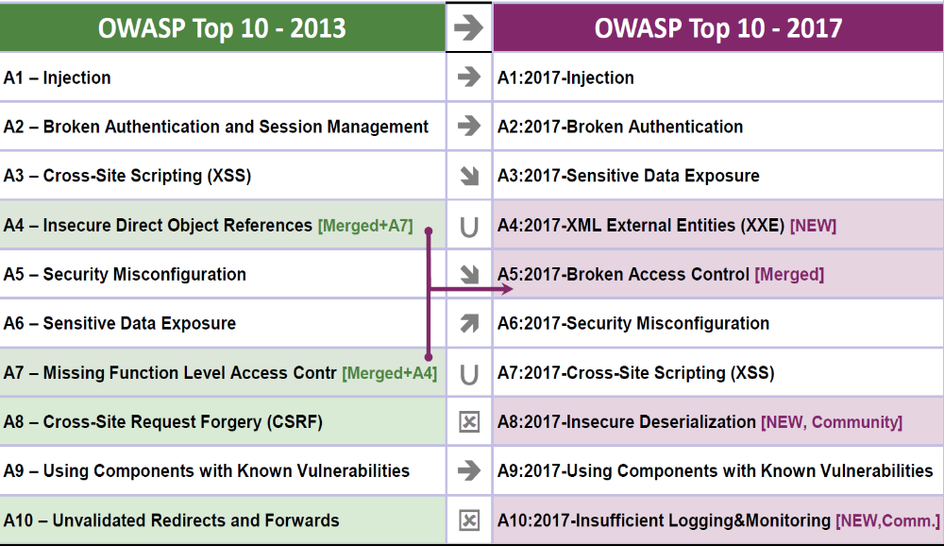

Slide 6
OWASP Top 10 (2017,2013,2010)
Injection (A1 2017 2013 2010)
Broken Authentication(A2 2017, A2 2013, A3 2010)
Sensitive Data Exposure(A3 2017, A6 2013)
XML External Entities (XXE) (A4 2017)
Broken Access Control (A5 2017)
Security Misconfiguration (A6 2017, A5 2013, A6 2010)
Cross-Site Scripting (XSS) (A7 2017, A3 2013, A2 2010)
Insecure Deserialization (A8 2017)
Using Components with Known Vulnerabilities (A9 2017, A9 2013)
Insufficient Logging & Monitoring (A10 2017)
Insecure Direct Object References (A4 2013, A4 2010)
Missing Function Level Access Control (A7 2013)
Cross-Site Request Forgery (CSRF) (A8 2013, A5 2010)
Unvalidated Redirects and Forwards (A10 2013, A10 2010)
Insecure Cryptographic Storage (A7 2010)
Failure to Restrict URL Access (A8 2010)
Insufficient Transport Layer Protection (A9 2010)

Slide 7
A1: Injection
“Injection attacks occur when the user is able to input untrusted data tricking the application/system to execute unintended commands.”
Injections can be – SQL queries, NoSQL queries, PHP queries, LDAP queries XPath, and OS commands.

Slide 8
Attack Scenarios
Uses untrusted data in the construction of the vulnerable SQL call:
String query = “SELECT * FROM accounts WHERE custID =‘” + request.getParameter(“id”) + “’” Query HQLQuery = session.createQuery(“FROM accounts WHERE custID=‘” + request.getParameter(“id”) + “’”
The attack modifies the ‘id’ parameter value in the browser to send: ‘ or ‘1’=‘1
http://example.com/app/accountView?id=‘ or ‘1’=‘1 String query = “SELECT * FROM accounts WHERE custID =‘’ or ‘1’=‘1’” Query HQLQuery = session.createQuery(“FROM accounts WHERE custID = ‘’ or ‘1’=‘1’”

Slide 9
A2: Broken Authentication
“Broken authentication occurs when the application mismanages session related information such that the user’s identity gets compromised. The information can be in the form of session cookies, passwords, secret keys etc.”

Slide 10
Attack Scenarios
Session timeout not properly set
User uses public computer to access an application
User close the browser without selecting “logout”
An attacker uses the same browser hours later and the user session is still valid

Slide 11
A3: Sensitive Data Exposure
Sensitive data not encrypted
Weak key generation and management
Weak algorithm, protocol, and cipher usage

Slide 12
Attack Scenarios
Credit card number encrypted using automatic database encryption and data is automatically decrypted when retrieved, allowing SQL injection flaw to retrieve credit card numbers in clear text
TLS not enforced in an insecure wireless network
Unsalted password used if upload flaw allowing attacker to retrieve password database

Slide 13
A4: XML External Entities (XXE)
Many older or poorly configured XML processors evaluate external entity references within XML documents. External entities can be used to disclose internal files using the file URI handler, internal file shares, internal port scanning, remote code execution, and denial of service attacks.

Slide 14
Attack Scenarios
<?xml version=“1.0” encoding=“ISO-8859-1”?>
<!DOCTYPE foo [
<!ELEMENT foo ANY >
<!ENTITY xxe SYSTEM file:///etc/passwd>]>
<foo.&xxe;</foo>
<!ENTITY xxe SYSTEM https://192.168.1.1/private>]>
<!ENTITY xxe SYSTEM file:///dev/random>]>

Slide 15
Tricky Web Applications
Universal Client
  Easy and Powerful (access to the Web Applications)
Stateless HTTP protocols
  Not designed for Applications
  Session state maintenance
  Session and Presentation Layer to mitigate TCP/IP
Protections from Web Applications
  Protect from Malicious users
  Protect Honest Users from Malicious Users
    The application can be a spring-board for attacks

Slide 16
Outline
Input/Output Validation for Web
  Prevent XSS, Response Splitting, Open Redirect by Output Validation
HTTP specific
  Not rely on the order of HTTP requests
  Use POST for not be logged or cached (when use GET)
Session State
  Strong Session Identifiers and Limit Session Lifetime
  Invalidating Existing Session Identifiers when Authenticate

Slide 17
Input and Output Validation for the Web
Expect the Browser has been subverted
Assume the Browser is an open book
Protect the Browser from Malicious Content
Cross-Site Scripting
Preventing Cross-Site Scripting
HTTP Response Splitting
Open Redirects

Slide 18
Injection Attacks
Attack Vectors
Weakness
Impacts

Slide 19
Injection Attack Vector
Environment variables
Parameters
External and Interval web services
Injection flaws occur
  Attacker can send hostile data to an interpreter

Slide 20
Injection Issues
SQL Injection
  malicious SQL statements are inserted into web sites
  to modify, steal or erase contents stored in database
XSS(Cross-site scripting)
  client-side scripts are injected into web pages
  to steal clients log, bypass access controls or install malicious software

Slide 21
Injection Issues
Command Injection
  user-supplied parameter becomes part of an OS command
Code Injection
  user-supplied parameter becomes part of the programming code
File Inclusion
  user-supplied parameter becomes the path to executable code
  to download and execute a local or remote file
$file = $_GET[‘file’];
system(“rm $file”);
$arg = $_GET[‘arg’];
eval(‘$var =‘ . $arg . ’;’);

Slide 22

SQL injection for the uPortal project (by JA-SIG)
String userAgent = request.getHeader("user-agent"); ... String sQuery = "DELETE FROM UP_USER_UA_MAP WHERE USER_ID=" + userId + " AND USER_AGENT='" + userAgent + "'"; ... stmt.executeUpdate(sQuery) ;

Slide 23
The Attack
A typical User-Agent header
  Mozilla/4.0 (compabible; MSIE 9.0; Windows NT 5.1; SV1)
  Mozilla/5.0 (X11; U; Linux i686; en-US; rv:1.7.8) Gecko/20050511
Attacker
  User-Agent: ‘OR 1=1
  Delete everything in the UP_USER_UA_MAP table

Slide 24
Expect the Browser has been Subverted
Web Proxy can modify cookies and other HTTP headers, hidden fields, values of radio boxes, and any other aspect of an HTTP request

Slide 25
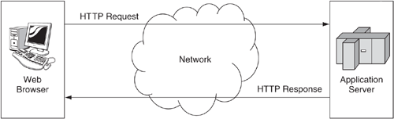
Your Application

Slide 26
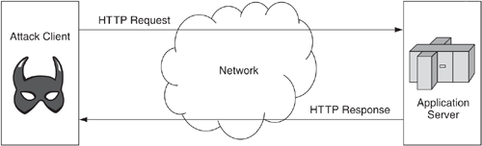
Your Application under Attack (attack client replaces the Web browser)

Slide 27
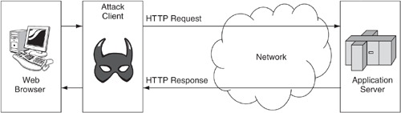
Application under Attack (attack client sits in front of the Web browser , as a proxy)

Slide 28
Hidden Values not really Hidden
<form method="POST" action="/transact.do">
<input name="auth" type="submit" value="Authorize"/>
<input type="hidden" name="amount" value="2600"/>
</form>
“amount” field invisible and immutable to average users
“amount” values can be any values from attackers

Slide 29
Radio Values are not really Radio
<form method="GET" action="/favorite.do">
<input type="radio" value="blue" name="clr" checked>Red</input>
<input type="radio" value="green" name="clr">Green</input>
<input type="radio" value="red" name="clr">Blue</input>
<input type="submit"/>
</form>
Normal value of clr: blue, green, or red
Attack can send values not of valid color
  magenta
  javascript:alert(‘pow’)
  Ùωà/ vv¿¿¿

Slide 30
Trust Validation
Cookies
  Flag every cookies access of name or value
  Control persist Cookies to a limited age
Hidden Fields
  As Input Sources to be validated
HTTP Headers
  As Input Sources to be validated

Slide 31
Static Analysis
Audit Cookies, Hidden Fields, and HTTP headers
  Audit them when use as input source
  Audit the way they are used
For example
  When cookie is accessed, it must be carefully treated
  When cookie is to persist, by setMaxAge, it must be noticed

Slide 32
The Browser is An Open Book
Open Book to the Attackers
  URLs
  URL parameters
  Hidden fields
  Cookie vaues
  Comments in HTML
  Reverse Engineering JavaScript
  Search Engine to dig deep to the applications
    Stale pages still deployed (but no longer recall)
  Decipher the data transfer protocol and message format between client and trading servers (by JavaScript or Ajax)

Slide 33
Hacking E*Trade (year 2000)
The E*Trade Authentication scheme
  Storing username + password (encrypted string by a home-brew encryption) in a cookie, when user login
  The encrypted string sent back to E*Trade for every request
  The cookie stored on user’s disk, if in a persistent login
The Attacks
  Cross-site scripting to get the cookie
  Recover the encrypted cookie (with simple primitive substitution cipher) with username and password
  Gain full control over the E*Trade account

Slide 34
Protect the Browser from Malicious Content

Slide 35
Cross-Site Scripting
A Web Application can’t afford to trust its clients, and the application must protect its clients too.
Cross-site scripting is the most widely reported software vulnerability

Slide 36

An Example JSP from AJAX
<c:if test="${param.sayHello}">
<!-- Let's welcome the user ${param.name} -->
Hello ${param.name}!
</c:if>
Cross-site scripting attack: Echo any string back to the browser
Unsuspecting victims could click on a link in an email message
Give up their authentication credentials to an attacker

Slide 37





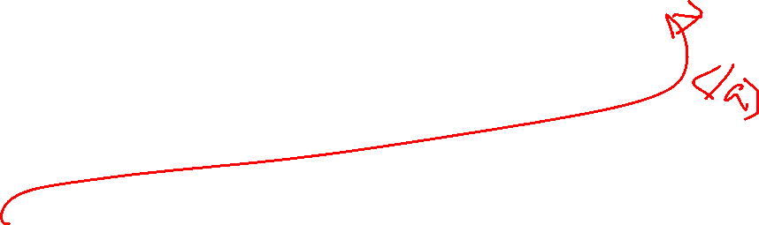
The Attack
If the name parameter has a value :Walter, the JSP will produce a message that says:
Hello Walter!
If the name parameter has a value:
%3Cscript%20src%3D%22http%3A//example.com/evil.js%22%3E%3C/script%3E
The server decode the parameter and send the Web browser:
Hello <script src="http://example.com/evil.js"></script>!
Web browser will execute the contents of
evil.js.

Slide 38

Cross Site Scripting (XSS)
Creates a malicious URL and Get a Victim to visit the URL
  inviting e-mail message
  social engineering
By clicking the link, the user sends the malicious code up to the vulnerable Web application.
The vulnerable Web application reflects the code back to the victim's browser.
The victim's browser executes the code as though it had legitimately originated from the application, and transmits confidential information back to the attacker.

Slide 39
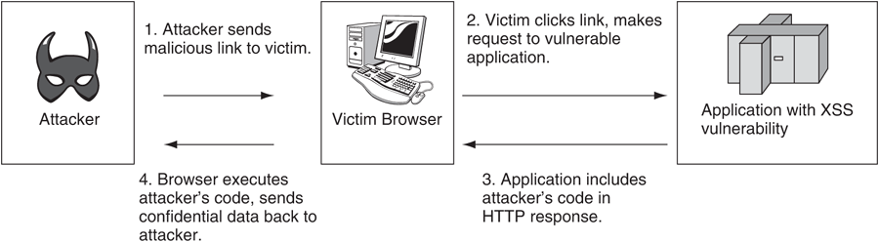
Reflected cross-site scripting

Slide 40
Client side XSS
Treeview JavaScript tree menu widget
  Look at URL
  Split page parameters
  Evaluates each as a JavaScript statement
  If the Javascript already in victim’s browser cache, the attack can be launched in the client side

Slide 41
XSS in client-side
<script> var d=""; var queryStr = window.location.search.substr(1); var i, splitArray; var BOX1, BOX2, BOX3, RD1, RD2, RD3 queryStr=unescape(queryStr) queryStr=queryStr.replace("+"," ").replace("+"," ") if (queryStr.length != 0) { splitArray = queryStr.split("&") for (i=0; i<splitArray.length; i++) { eval(splitArray[i]) } } </script>

Slide 42
XSS from database (name with Malicious data)
String query = "select * from emp where id=?"; PreparedStatement stmt = conn.prepareStatement(query); stmt.setString(1, eid); ResultSet rs = stmt.executeQuery(); if (rs != null) { rs.next(); String name = rs.getString("name"); out.println("Employee Name: " + name); }

Slide 43
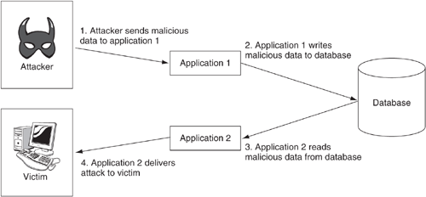
Stored XSS (for multiple applications)

Slide 44
The First XSS Worm
Self-propagating cross-site script attack hit MySpace in 2005
  Any MySpace users who viewed Samy’s profile, will add him to their own profile
In 24 hours, Samy amassed over 1 million users
Using XMLHTTPRequest
  JavaScript object in AJAX
  Spreading 1,000 users every few seconds
If not for fun
  Exploiting unpatched IE, a massive botnet can be formed

Slide 45
The XSS Worm
Samy knew how to insert HTML into profile page, but MySpace stripped out the word “javascript”
Samy break the word JavaScript into two lines and place script within CSS tag
Instruct browser to invite Samy as a friend and add him as a hero to the visitor
  XMLHTTPRequest - a JavaScript Object used in AJAX
If 5 users view Samy’s profile, 5 new friends
If 5 people viewed each of them, 25 new friedns

Slide 46
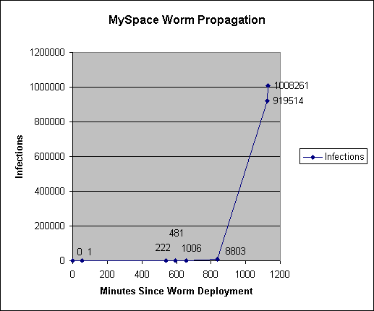

Slide 47
The XSS worm to embed JS
MySpace uses blacklisting
  Not allow <script>, <body> onClicks, onAnythings, hrefs with JavaScript
  But IE allow JavaScript within CSS tags:
  <div style=“background:url(‘javascript:alert(1)’)”>
Hard to code JS due to single quotes and double quotes used up already
  Store JS and execute it by name to use single quotes
  <div id=“mycode” expr=“alert(‘hah!’)”
  style=“background:url(‘javascript:eval(document.all.mycode.expr)’)”>

Slide 48
The XSS worm to bypass the javascript stripping
Some Browser interpret java\nscript as javascript
For example
<div id="mycode" expr="alert('hah!')"
style="background:url('java
script:eval(document.all.mycode.expr)')">

Slide 49
To use double quotes in XSS worm
MySpace stripped out all escaped quotes, including single and double quotes (ex: foo\”bar)
Convert decimal to ASCII to produce the quotes
<div id="mycode" expr="alert('double quote: ' +
String.fromCharCode(34))" style="background:url('java
script:eval(document.all.mycode.expr)')">

Slide 50
To post the code to the user’s profile
Get the source of the profile page, use document.body.innerHTML
  MySpace strips the word innerHTML
  Use eval to bypass
  alert(eval(‘document.body.inne’ + ‘rHTML’));

Slide 51
To access other pages
Use XML-HTTP to make HTTP GET and POST, with onreadystatechange (but MySpace stripped)
Bypass
  eval('xmlhttp.onread' + 'ystatechange = callback');

Slide 52
Searching problems
We can use GET by XML-HTTP
You can not search a specific ID in a page (that page contains javascript with that ID
Use eval again
var index = html.indexOf('frien' + 'dID');

Slide 53
Other problems
XML-HTTP won’t allow GET/POST to different domain (on profile.myspace.com, but post to www.myspace.com)
if (location.hostname == 'profile.myspace.com')
document.location = 'http://www.myspace.com' +
location.pathname + location.search;
Pre-POST page with a random hash (for example, “Are you sure you want to add this user as a friend” page)
  Mimic a browser to send GET to get the hash, parse the hash and perform POST with that hash
…other details …

Slide 54
Preventing XSS

Slide 55
Represent < in HTML
Represent < in HTML
  <
  %3C
  &lt;
  &#x3c;
  &#060;
<script> in IE
  <sc
  ript>

Slide 56

Input Validation and output Encoding to prevent XSS
<c:if test="${param.sayHello}"> <!-- Let's welcome the user ${param.name} --> <% String name = request.getParameter("name"); if (!ID_REGEX.matcher(name).matches()) { throw new ValidationException("invalid name"); } %> Hello <c:out value="${param.name}"/>! </c:if>

Slide 57
Input Validation and output Encoding to prevent XSS
String query = "select * from emp where id=?"; PreparedStatement stmt = conn.prepareStatement(query); stmt.setString(1, eid); ResultSet rs = stmt.executeQuery(); if (rs != null) { rs.next(); String name = rs.getString("name"); if (!NAME_REGEX.matcher(name).matches()) { throw new ValidationException("invalid emp name"); } ... out.println("Employee Name: "+URLEncoder.encode(name, "UTF8")); }

Slide 58
Vulnerable IT world: Sharing
Testing is critical (monkey testing)
Early Birds
Web Platform as a playground
  IPCam
  NAS
  Trapdoor embedded in a web page transparently
  NAT to NAT (peer to peer)
  Home network devices

Slide 59
HTTP Response Splitting
Read from “author” and set in a cookie
  String author = request.getParameter("author");
  Cookie cookie = new Cookie("author", author);
  cookie.setMaxAge(cookieExpiration);
  response.addCookie(cookie);
Normal Parameter: Jane Smith
HTTP/1.1 200 OK
Set-Cookie: author=Jane Smith
Attack: Wiley Hacker\r\n\r\nHTTP/1.1 200 OK\r\n..
HTTP/1.1 200 OK
Set-Cookie: author=Wiley Hacker
HTTP/1.1 200 OK

Slide 60
Mishandle of the response splitting
Provide malicious content to the victim browser, similar to a reflected cross-site scripting attack
Confuse a Web Proxy: Web proxy sending the second HTTP response to a different user, or sending different user’s data to the attack
Defending
  Prevent from including unvalidated data in HTTP headers
  Filtering response characters, without CR, LF , : and =.

Slide 61
Open Redirects
Phishing: luring potential victims to an attacker-controlled Web Site
Cross-site Script
Open Redirects: Take victims to a legitimate Web and immediately forwards them to another site controlled by the attackers

Slide 62




Open Redirect: send a victim a link to a site specified by the attacker
String nextPage = request.getParameter("next"); if (nextPage.matches("[a-zA-Z0-9/:?&_\\+]+") { response.sendRedirect(nextPage); }

Slide 63
Control where the redirect goes
String nextPage = pageLookup.get(request.getParameter("next")); response.sendRedirect(nextPage);

Slide 64
Limit the attacker’s ability to make use of a redirect
String nextPage = request.getParameter("next"); if (nextPage.matches("[a-zA-Z0-9/]+") { response.sendRedirect("http://example.com/" + nextPage);

Slide 65
Static Analysis
Treat XSS as Problems of (also HTTP response splitting and open redirects)
  Input Validation
  Output Validation
Input Sources: the database, and any other datastore

Slide 66
HTTP Considerations
Use POST, Not GET
Request Ordering
Error Handling
Request Provenance

Slide 67
Use POST, Not GET

Slide 68
The GET request (logged)
GET /csp/login.jsp?usr=bvc&passwd=123 HTTP/1.1
Accept: */*
Accept-Language: en
Accept-Encoding: gzip, deflate
Referer: https://www.example.com/dashboard/home.jsp
User-Agent: Mozilla/4.0 (compatible; MSIE 9.0; Windows NT 5.1;SV1)
Pragma: no-cache
Connection: keep-alive
Host: www.example.com

Slide 69
The POST request (not logged)
POST /csp/login.jsp HTTP/1.1
Accept: */*
Accept-Language: en
Accept-Encoding: gzip, deflate
Cookie: brId=3004
Referer: https://www.example.com/dashboard/index.jsp
User-Agent: Mozilla/4.0 (compatible; MSIE 9.0; Windows NT 5.1;
SV1)
Content-Type: application/x-www-form-urlencoded
Content-Length: 212
Connection: keep-alive
Host: www.example.com
usr=bvc&passwd=123

Slide 70
XSS vulnerability (even POST only)
Click <a href="JavaScript:document.money.submit()">here</a>. <div style="height:0px; overflow: hidden"> <form method="POST" name="money" action="http://example.com/login.jsp"> <input name="usr" value=""/> <input name="passwd" value="alert('xss payload here')"/> </form> </div>

Slide 71
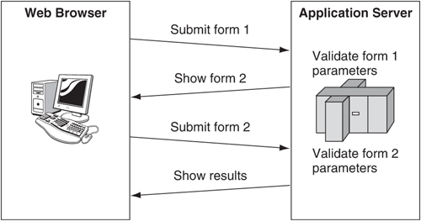
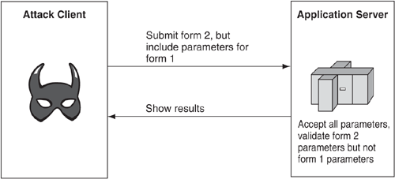
Request Ordering

Slide 72

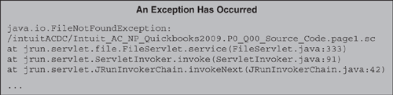
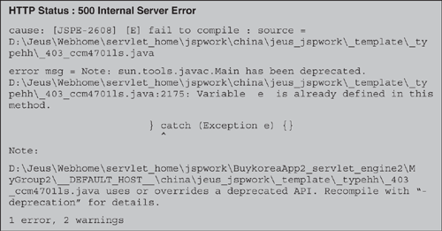
Error Handling

Slide 73
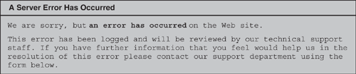
Good Error Message

Slide 74
Request Provenance (cross-site request forgery attack)
<form method="POST" action="/new_user" >
Name of new user: <input type="text" name="username">
Password for new user: <input type="password" name="user_passwd">
<input type="submit" name="action" value="Create User">
</form>
If the administrator visit the following malicious page (with active session:
<form method="POST" action="http://www.example.com/new_user">
<input type="hidden" name="username" value="hacker">
<input type="hidden" name="user_passwd" value="hacked">
</form>
<script>
document.usr_form.submit();
</script>

Slide 75
The random request identifier
<form method="POST" action="/new_user" >
Name of new user: <input type="text" name="username">
Password for new user: <input type="password“ name="user_passwd">
<input type="submit" name="action" value="Create User">
<input type="hidden" name="req_id" value="87ae34d92ba7a1">
</form>

Slide 76
Maintaining Session State
Use Strong Session Identifiers (128bits)
Enforce a Session Idle Timeout and a Maximum Session Lifetime
Begin a New Session upon Authentication (and invalidate the old)

Slide 77

Strong Session Identifiers
Number of Seconds to Guess a Session Identifier
B: number of bits of entropy in the session ID
A: number of guesses an attack can try each session
S: number of valid session ID available to be guessed at any given time (active users)

Slide 78
Examples
64-bit session identifier, 32 bits of entropy
10 guesses per second and 10000 valid session identifiers at any given moment (a large web site)
Expected time to guess a valid session identifier
  2³²/(2* 10*10000) ~= 2 * 10 ⁴ ~= 6 hours
128 bits session identifier, 64 bits of entropy
292 years

Slide 79
128-bit session identifier
<session-descriptor> <session-param> <param-name>IDLength</param-name> <param-value>25</param-value> <!--Specified in characters--> </session-param> ... </session-descriptor>

Slide 80
Invalidates a session after session lifetime
public void doFilter(ServletRequest request, ServletResponse response, FilterChain chain) throws IOException, ServletException { if (request instanceof HttpServletRequest) { HttpServletRequest hres = (HttpServletRequest) request; HttpSession sess = hres.getSession(false); if (sess != null) { long now = System.currentTimeMillis(); long then = sess.getCreationTime(); if ((now - then) > MAX_SESSION_LIFETIME) { sess.invalidate(); } } } chain.doFilter(request, response); }

Slide 81
Invalidates existing session
public void doLogin(HttpServletRequest request) { HttpSession oldSession = request.getSession(false); if (oldSession != null) { // create new session if there was an old session oldSession.invalidate(); HttpSession newSession = request.getSession(true); // transfer attributes from old to new Enumeration enum = oldSession.getAttributeNames(); while (enum.hasMoreElements()) { String name = (String) enum.nextElement(); Object obj = oldSession.getAttribute(name); newSession.setAttribute(name, obj); } } authenticate(request); // username/password checked here }

Slide 82
Using the Struts Framework for Input Validation
Setting Up the Struts Validator
Use the Struts Validator for All Actions
Validate Every Parameter
Maintain the Validation Logic

Slide 83
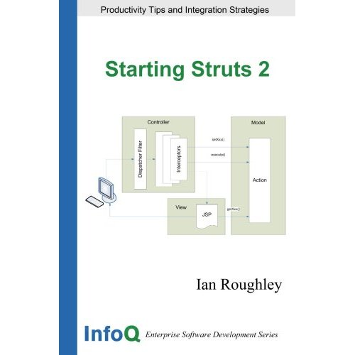
Use the Struts Validator for All Actions
http://struts.apache.org/

Slide 84

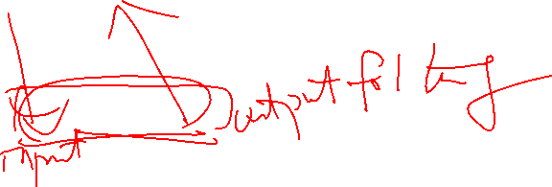

Model-View-Controller (MVC) architecture
Model
  the business or database code
View
  the page design code
Controller
  the navigational code
The Struts framework is designed to help developers create web applications that utilize a MVC architecture.

Slide 85
Key Components of the framework
A "request" handler provided by the application developer that is mapped to a standard URI.
A "response" handler that transfers control to another resource which completes the response.
A tag library that helps developers create interactive form-based applications with server pages.

Slide 86
The Struts Web Application Framework
Follow the Model-View-Controller (MVC) pattern
MVC for Input validation
Struts plays the role of the controller
  Dispatching update requests to the model and invoking the view to display the model to the user
The major feature: the Struts Validator
  Checking user input to make sure that it is of appropriate form and content before being turned over to an application’s business logic

Slide 87
The Validator
To ensure, for example
  Boolean values are only T or F
  Free-form strings are of a reasonable length and composition
  Phone numbers contains exactly 10 digits
Format of checks
  An ActionForm object: data from the HTTP request
  A form bean mapping: a configuration file entry. Mapping the name of an ActoinForm class to a logical name used in the configuration files
  An Action class: define an execute() method to carry out the request, and invoke business logic
  A validator form: configuration file, specifying the checks, before the ActionForm populated from an HTTP request

Slide 88
Setting up the Struts Validator
<plug-in className=“org.apache.struts.validator.ValidatorPlugIn”>
<set-property property=“pathnames”
value=“/WEB-INF/validator-rules.xml,/WEB-INF/validation.xml”/>
</plug-in>

Slide 89
Struts-config.xml: a form bean and action mapping
<struts-config> <form-beans> <form-bean name="passwdForm" type="com.bonsecure.form.PasswordForm"/> </form-beans> ... <action-mappings> <action path="/app/login" type="com.bonsecure.action.LoginAction" name="passwdForm" scope="request" validate="true" /> </action-mappings> ... </struts-config>

Slide 90
validation.xml: validation criteria for the bean, 6-12 for pass, and alphunum only
<form-validation> <formset> <form name="passwdForm"> <field property="passwd" depends="minlength, maxlength, mask"> <arg0 key="label.user.passwd"/> <arg1 name="minlength" key="${var:min}" resource="false"/> <arg2 name="maxlength" key="${var:max}" resource="false"/> <var> <var-name>min</var-name> <var-value>6</var-value> </var> <var> <var-name>max</var-name> <var-value>12</var-value> </var> <var> <var-name>mask</var-name> <var-value>^[0-9a-zA-Z]+$</var-value> </var> </field> </form> </formset> </form-validation>

Slide 91
Disable Struts Validator
<action path="/download" type="com.Website.action.DownloadAction" name="downloadForm" scope="request" input=".download" validate="false"> </action>

Slide 92
Default true for validate flag
<action path="/download" type="com.Website.action.DownloadAction" name="downloadForm" scope="request" input=".download"> </action>

Slide 93
Re-implement validate() by calling super.validate()
public abstract class MyForm extends ValidatorForm { ... public ActionErrors validate(ActionMapping mapping, HttpServletRequest request) { super.validate(mapping, request); this.errors = errors; doSpecialValidation(mapping, request); } }

Slide 94
Validate Every Parameter

Slide 95
DateRangeForm: a ValidatorForm with two fields, startDate and endDate
public class DateRangeForm extends ValidatorForm { String startDate, endDate; public void setStartDate(String startDate) { this.startDate = startDate; } public void setEndDate(String endDate) { this.endDate = endDate; } }

Slide 96
Validation form to validate DateRangeForm
<form name="DateRangeForm"> <field property="startDate" depends="date"> <arg0 key="start.date"/> </field> <field property="endDate" depends="date"> <arg0 key="end.date"/> </field> <field property="scale" depends="integer"> <arg0 key="range.scale"/> </field> </form>

Slide 97
Confusion names
<form-validation> <formset> <form name="ProjectForm"> ... </form> <form name="ProjectForm"> ... </form> </formset> </form-validation>

Slide 98

Code execution/
File Inclusion
 | usage
exec/passthru/ system/ shell_exec | system(‘ls’); | CVE-2008-4796 CVE-2001-1020 CVE-2015-5227 (WordPress plugin)
eval/assert | assert(‘system(“ls”);’); | CVE-2015-2208 (PHPMoAdmin) CSAW CTF 2016 - mfw
include/require | include(‘flag.php’); | CVE-2003-1086 (pMachine)
extract | extract($_GET); die($ctime($atime)); ?ctime=system&atime=ls | 0CTF 2015 - forward
preg_replace | preg_replace ('/known/e', ‘system(‘ls’);’, ‘xxx’); | CVE-2014-8998 (XmlImportExport plugin in MantisBT)
unserialize | unserialize($_GET[‘name']); ?name=O:4:"Blog":1:{s:3:"vul";s:10:"phpinfo();";} | CVE-2014-1691 (Horde Framework) CVE-2014-8791 (Tuleap)

Slide 99
Code execution/
File Inclusion
 | usage
create_function | create_function('$arr', 'return assert("system('ls');");')
call_user_func / call_user_func_array | call_user_func('assert', $_REQUEST[‘cmd']); call_user_func_array('assert', array($_REQUEST['cmd']));
array_filter / array_map | $func = $_REQUEST['func']; $cmd = array($_POST['cmd'],); array_filter($cmd, $func); ?func=assert&cmd=phpinfo();
file / readfile / file_get_contents | file_get_contents($_GET['file']);
unlink | unlink($_GET['file']);

Slide 100

OS Command execution
CVE-2013-2251 (Struts2)
CVE-2009-0497 (Openfire)
XXE injection
CVE-2016-0457 (Management Pack for Oracle E-Business Suite)

Slide 101
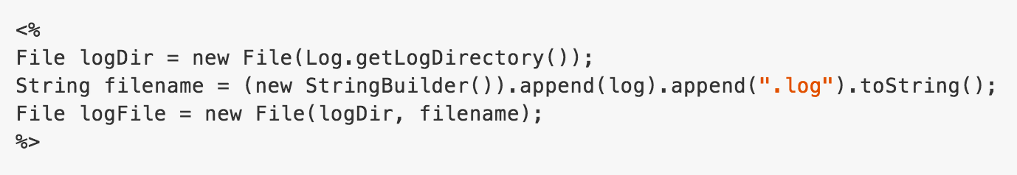
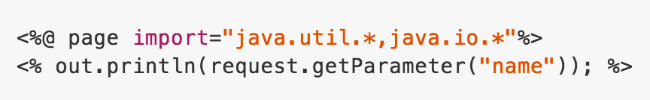
Directory traversal
CVE-2009-0497 (Openfire)
CVE-2016-6601 (WebNMS Framework)
XSS
CVE-2009-0497 (Openfire)

Slide 102

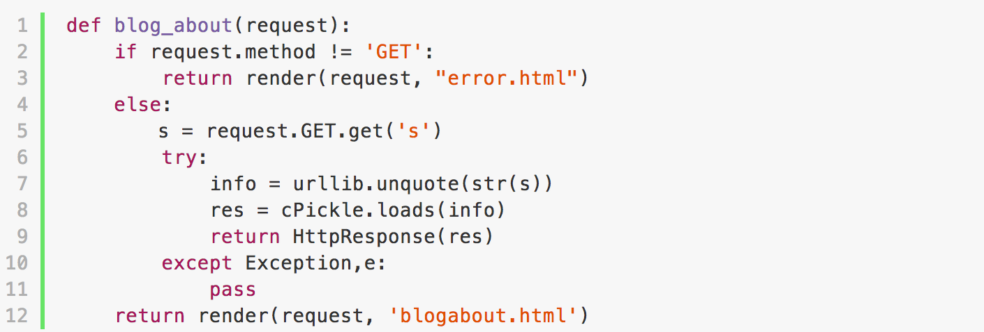
OS Command execution
module | function
pickle/cPickle | pickle.load / pickle.loads
Example
Exploit Payload

Slide 103
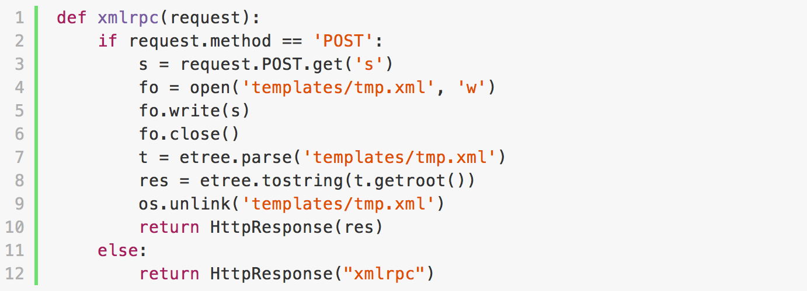
File manipulation
module | function
(builtin) | write / unlink
Example
Exploit Payload

Slide 104
Summary
Not Trust any of the data received as part of an HTTP request
Web Attacks (using output validation)
  Cross-site Scripting
  HTTP response splitting
  Open redirects
POST and GET
  GET data will be cached and stored in log file
  GET and POST data are in the clear (so using encryption to protect sensitive data)
Knowing the Session Identifier, the attacker can control the user’s session

